Slide 1
Hangman
By
Forrest Wong, Arafat Uddullah, & Shittul Mona

Slide 2
Description
To make the game of hangman, users interact with the page by letting them select letters to reveal the word.
Each time the user selects the wrong word, the hangman will receive a body part and eventually be hanged.

Slide 3
Functionality of the Project
Ability to choose topic
Letters removed after selection
Ability to forfeit
Ability to play again after loss/victory
Wins/losses are counted and displayed

Slide 4
Demo

Slide 5


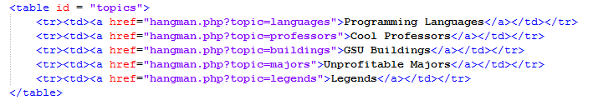
Code snippets
main.php

Slide 6

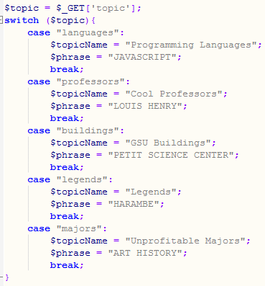
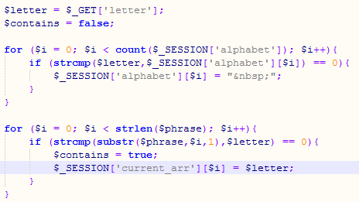
Code snippets
hangman.php

Slide 7
Questions?

